Slide 1

Cost of Living and Airbnb: A Statistical Review
Ingrid Firmino

Slide 2

Airbnb was born in 2007, in San Francisco
6M active listings worldwide
100K cities and towns with active Airbnb listings
Present in 220+ Countries
1B+ guests arrival
$13.8K earned by the typical US host in 2021
Source: news.airbnb.com

Slide 3
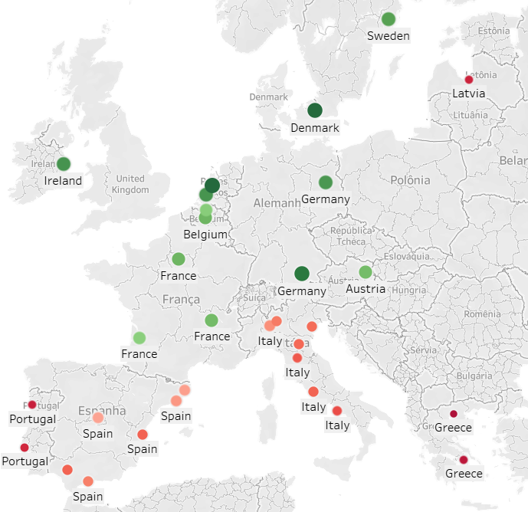
Average salary in Europe

Slide 4
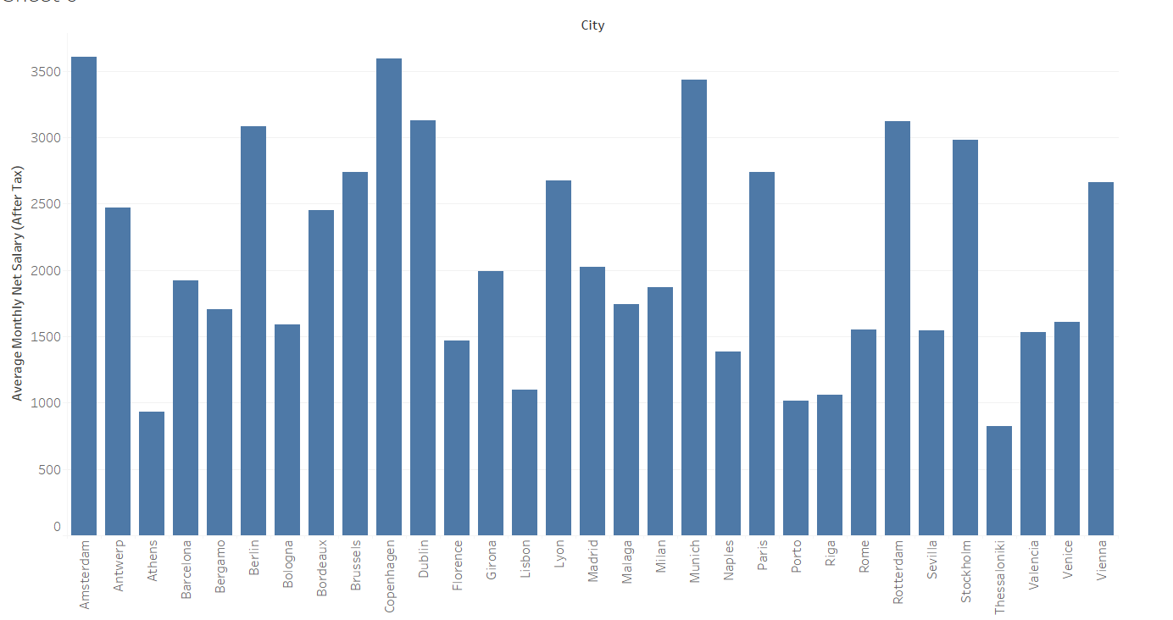
Average salary in Europe

Slide 5
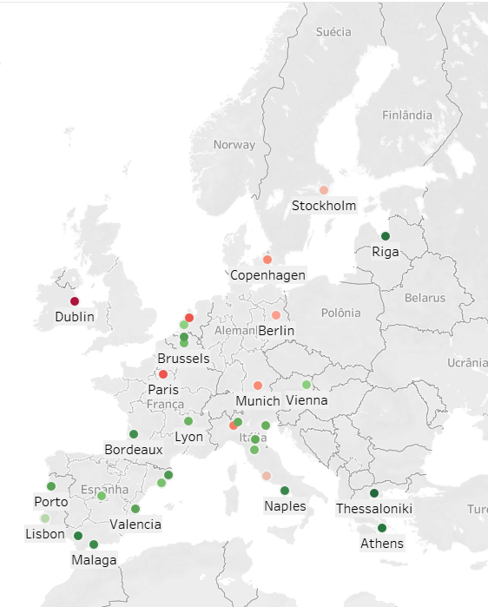
Average Renting Price of a 3 bedroom Apartment

Slide 6
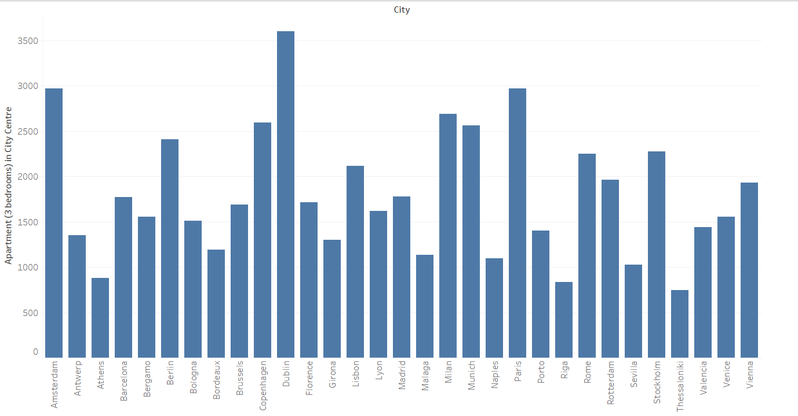
Average Renting Price of a 3 bedroom Apartment

Slide 7
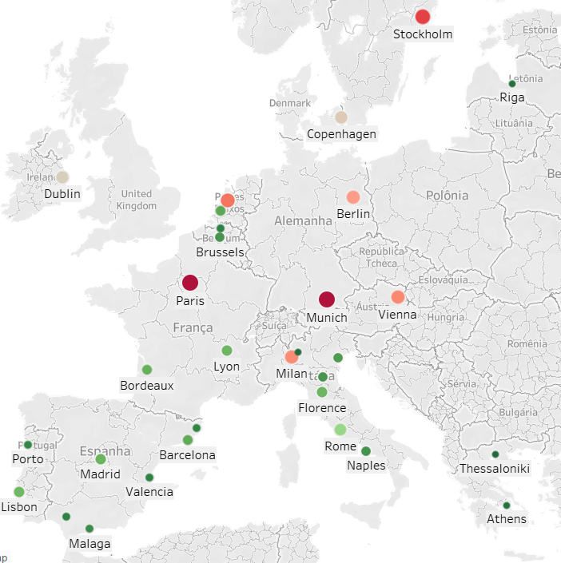
Average Square Meter Price

Slide 8
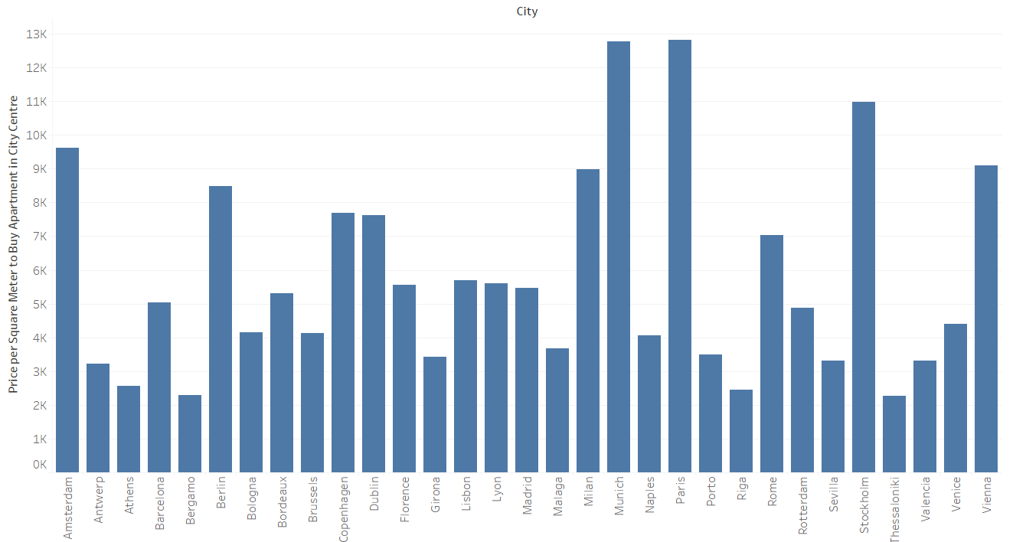
Average Square Meter Price

Slide 9
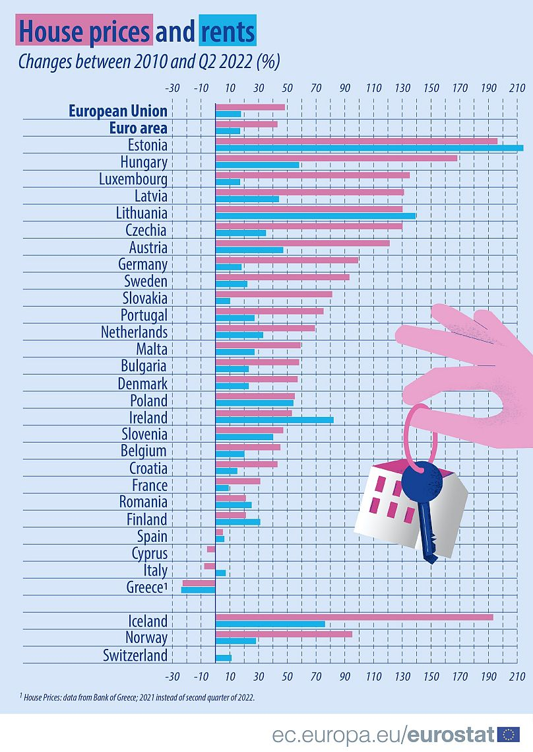
Source: ec.europa.eu/eurostat

Slide 10
What does Airbnb have to do with it?

Slide 11
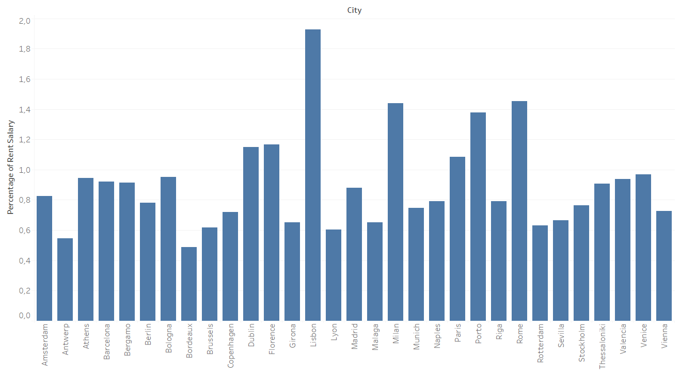
% of rent a 3 bedroom compared to the avg salary
P_value = 0.047
Statistics = -1.71
H0: mu >= 100%,
H1: mu<100%

Slide 12
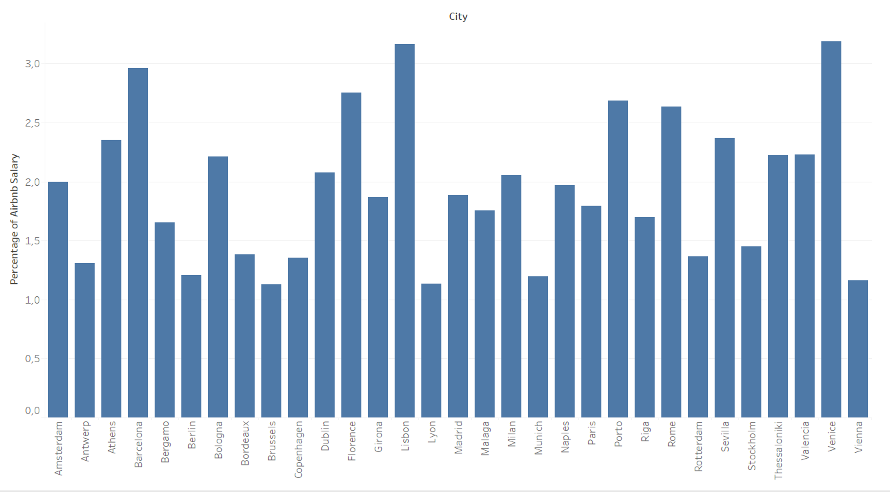
% of rent a Airbnb for a month bedroom compared to the avg salary
P_value = 0.9999
Statistics = 8.56
H0: mu >= 100%,
H1: mu<100%

Slide 13
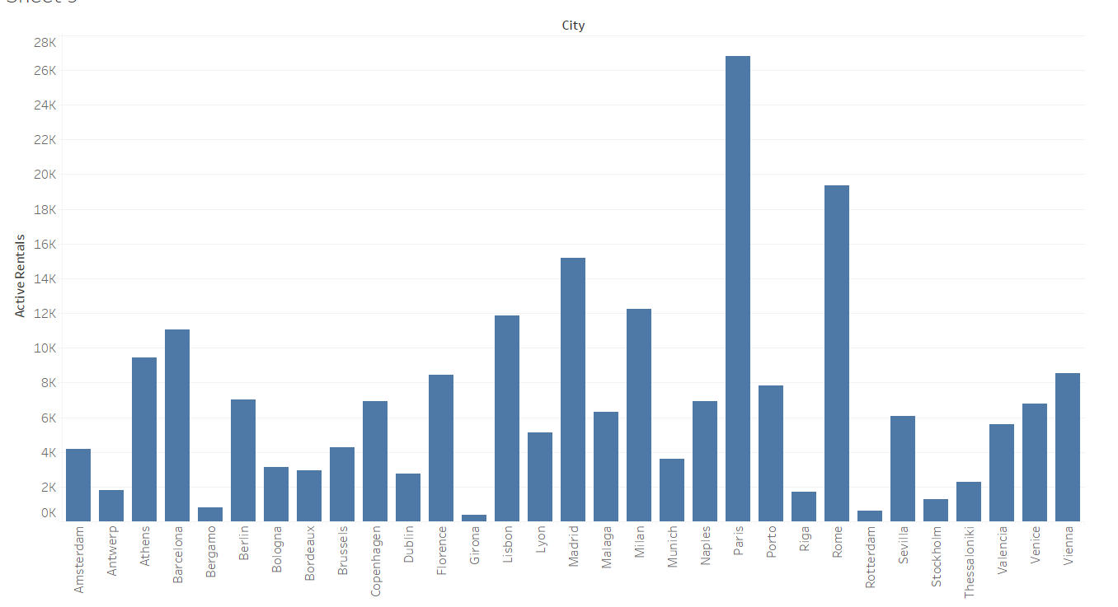
Active Airbnb Rentals

Slide 14
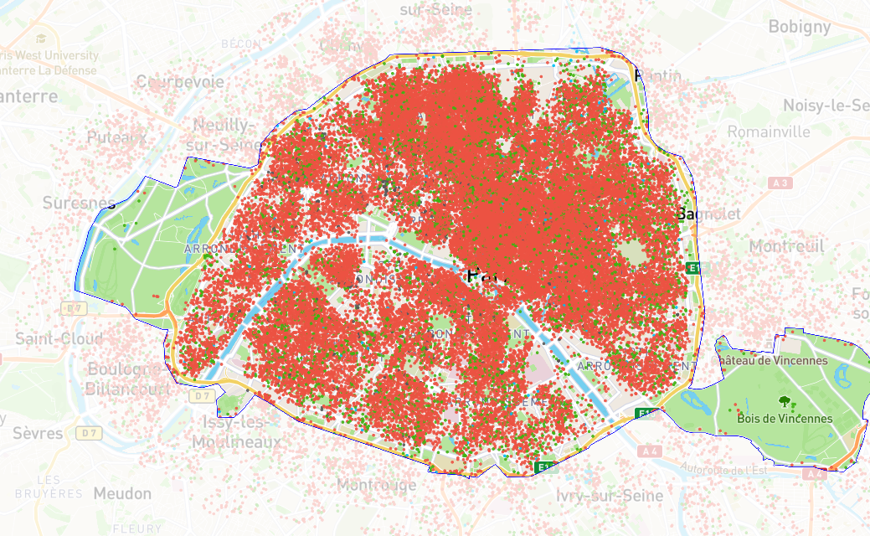
Active Airbnb Rentals

Slide 15
If you were an investor, what would you do?

